Slide 1





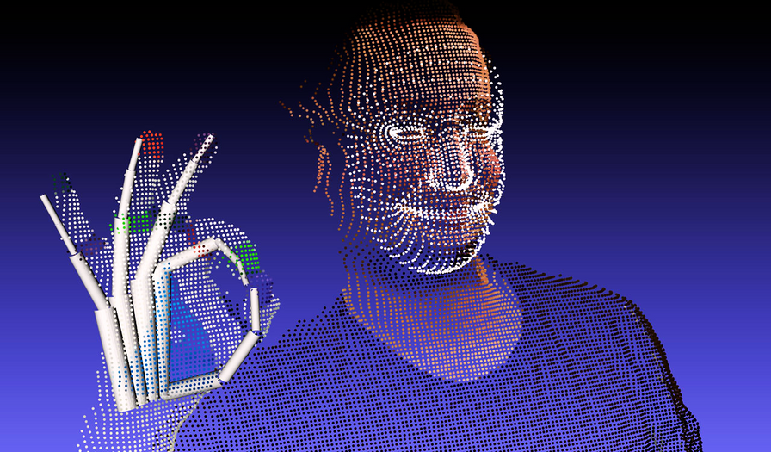

SIGN LANGUAGE
TRANSLATION SYSTEM
Theme: Wearables
Team Binary Pandits:
Abhinav Deshpande
Ajitesh Kumar Singh
Vedant M

Slide 2



PROBLEM STATEMENT AND IDEA
Problem Statement
Our Solution over current solution
Communication barriers exist for speech-impaired individuals, hindering interaction.
Non-sign language users struggle to understand hand gestures effectively.
Enhance existing ASL solutions with innovative technology.
For people not familiar with sign language, convert ASL gestures into speech for universal comprehension.
Integrating them into social interactions with non-sign language users, using solutions already familiar to them.
EMPOWERING 💪 SPEECH-IMPAIRED INDIVIDUALS TO FEEL EQUAL ⚖️ BY GIVING THEM THE VOICE THEY DESERVE! 💯

Slide 3





CURRENT SOLUTIONS
We have the American Sign Language (ASL) allowing the deaf and dumb to communicate.
The deaf and dumb can’t effectively communicate in a mixed social gathering where others may not know ASL.
However, people not familiar with the ASL will not understand what is going on !!?
Obviously these practices are flawed and cannot reduce the communication gap between the deaf-dumb and others
A deaf and dumb person can communicate with a normal person only by the use of text to speech services
We need a better solution than ASL and text-to-speech
Which means the specially abled person will have to write out an entire sentence before it can be converted to speech to be heard by the other person!

Slide 4

PROPOSED SOLUTION
A wearable device on wrist and top of the hand translating American Sign Language (ASL) gestures into text and speech.
Features a glove embedded with sensors and an Arduino Nano microcontroller.
Hand movements are translated in real-time via Bluetooth to a smartphone app.
Symbols are displayed on the app screen with voice output for seamless communication.

Slide 5


BENEFITS
Accessibility: The device provides a means for deaf individuals to communicate with non-signers, increasing accessibility and inclusivity in various social and professional settings.
01
Real-time Translation: By converting ASL gestures into text and speech in real-time, the device facilitates seamless communication without the need for an interpreter, enabling more spontaneous interactions.
02
Education: The project can be used as an educational tool for learning ASL symbols, both for deaf individuals and those interested in sign language interpretation.
03
Customization: The device can be further customized and optimized based on user feedback and advancements in sensor technology, enhancing its accuracy and usability over time.
04

Slide 6
IMPLEMENTATION AND TECHNOLOGY USED
The accelerometer gauges the orientation of the user's palm, providing data on tilt and movement.
Flex sensors embedded within the glove capture intricate details such as the angles of finger, thumb, and palm bends.
The sensor readings undergo analysis and categorization, correlating to distinct ASL letters and numbers.
Leveraging the processing power of an Arduino Nano microcontroller, the interpreted sensor data is translated into recognizable ASL symbols.
Seamless integration with Bluetooth technology facilitates the transmission of interpreted symbol data to an external mobile app.
Using a combination of visual displays and voice output mechanisms, the recognized ASL symbols are presented to the user, enabling both visual and auditory comprehension.

Slide 7
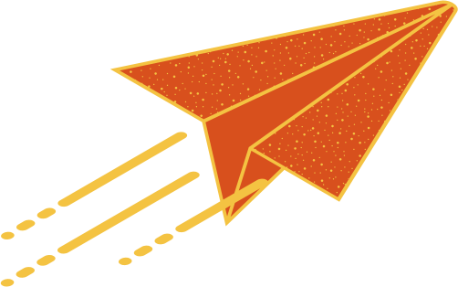
IMPLEMENTATION AND TECHNOLOGY USED
TECHNOLOGY TO BE USED:
Sensors
Microcontroller
Communication Module
External Device Integration
Flex Sensors: These willl be attached to each finger and measure the degree of flexion in each finger joint to detect sign language gestures.
Arduino Nano willl be used as the main controller to process data from the sensors, accelerometer.
The bluetooth module will be connected to an app via bluetooth connection.
Bluetooth(HC-05 module) or other wireless communication technology can be used to send and receive data between the glove and external devices.
It will interpret the sign language gestures, convert them into text, and send data for the speech synthesis.
The letters and numbers detected by the arduino nano will be displayed along with voice output in the app.
Accelerometer: It will provide orientation and motion data, which will help distinguish signs and gestures.

Slide 8
FUTURE SCOPE
Integration with Various Services
Expanded Language Support:
Home Automation
Health Monitoring:
The system can be further integrated with various services, potentially creating employment opportunities for individuals with hearing and speech impairments.
Expanding the range of supported sign languages is essential, as different regions have their own unique sign languages. Supporting more languages can make the technology more inclusive.
The system can be enhanced with control capabilities for home automation, enabling users to control various household appliances using sign language.
The system can be paired with fitness sensors to monitor the health and well-being of individuals, contributing to their overall quality of life.

